Slide 1


Talend Data Integration
Creating master Jobs
Orchestration components
Error handling
Using context variables
AUTHOR: SERGEY MOUKAVOZTCHIK
January, 2018

Slide 2
AGENDA
Using context variables
Creating and using execution contexts
Understanding and using context variables
Using repository context variables
Managing contexts
Creating master Jobs
Controlling Job execution using a master Job
Passing parameters to the sub job and handling job output
Orchestration components
Iterating
tIterateToFlow / tFlowToIterate
tUnite/tReplicate
Pre and Post Job
Error handling
Detecting and handling basic errors
Raising a warnings and errors
Logging

Slide 3
CONTEXTS
Creating and using execution contexts
Understanding and using context variables
Using repository context variables
Managing contexts
(see p. 65 -80 of UG)

Slide 4
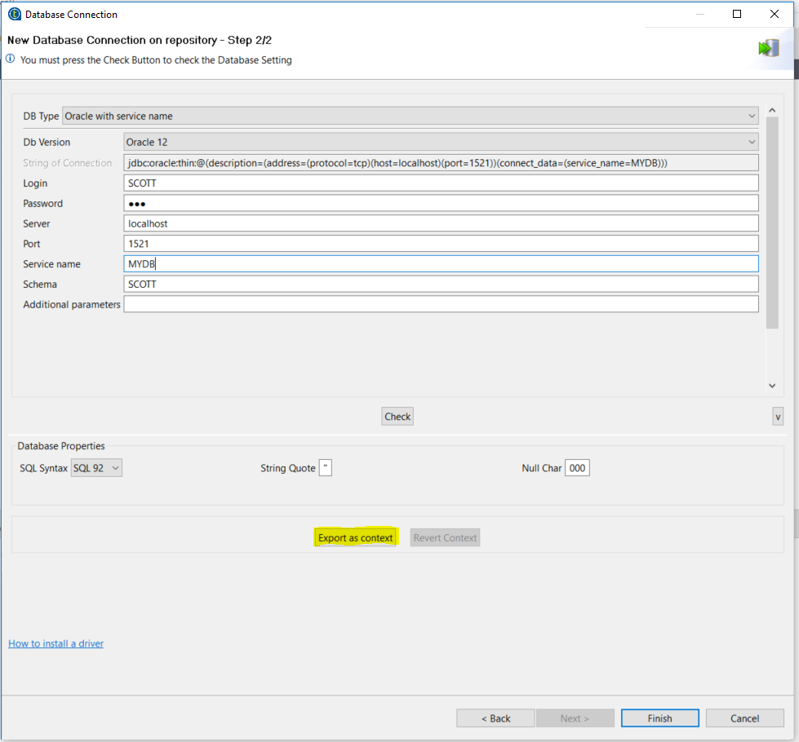
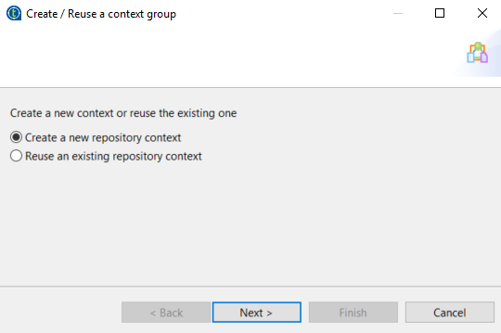
DB CONTEXTS
Create new DB connection in repository
Press “Export as context”

Slide 5
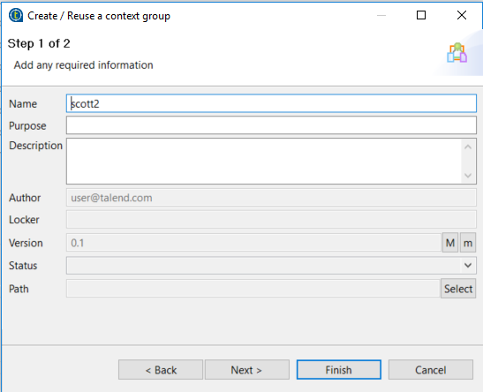
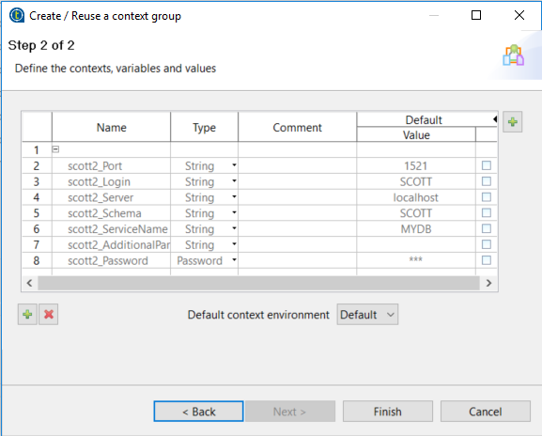
DB CONTEXTS
Enter name of new context
Validate the params and press Finish

Slide 6
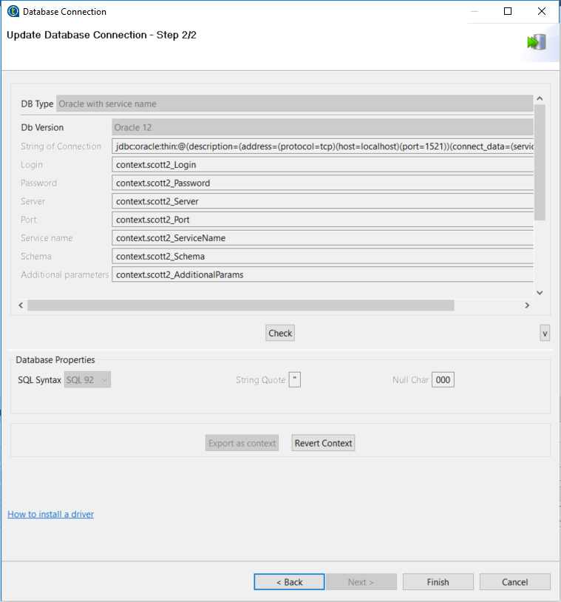
DB CONTEXTS
Now DB connection params will be substituted with context variables

Slide 7
MASTER JOBS & SUBJOBS
tRunJob component
Creating master Jobs
Controlling Job execution using a master Job
Passing parameters to the sub job and handling job output

Slide 8
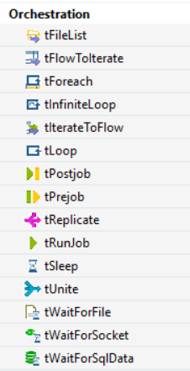
ORCHESTRATION COMPONENTS
Iterating:
tForEach
tLoop
tInfiniteLoop
tIterateToFlow / tFlowToIterate
tUnite/tReplicate
Pre and Post Job

Slide 9
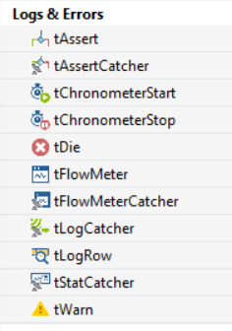
ERROR HANDLING
Detecting and handling basic errors
Raising a warnings and errors
Logging

Slide 10
Thanks for your attention!
Any questions?
AUTHOR: Sergey Moukavoztchik
Lead Software Engineer
January, 2018

